Slide 1

Status Asthmaticus
Christopher Lacey, Pharm D Candidate
Preceptor: Marla Tanski, Pharm D

Slide 2
Objectives
To describe the pathophysiology and pathogenesis of status asthmaticus (S.A.)
To recall the signs and symptoms associated with S.A.
Explain the management of S.A.
To review the treatment options for S.A.
To answer questions pertaining to drug indication, mechanism of action, and dosing of medications used to treat S.A.
To review a patient case and apply the aforementioned objectives.

Slide 3
Patient Case
JT is a 9 yo female, Wt: 24 kg, transferred to ACH on 05/23/2014 in S.A.
CC: Difficulty breathing
HPI: Unrecognized intermittent to mild, persistent asthma, previously diagnosed as bronchitis.
History of wheezing over the last few years
Intermittent albuterol by nebulization
Has not taken asthma medications for a while
Fever for the past 12 Hr
Progressive difficulty breathing over the past 24 Hr
Immunizations are current
Unclear if JT has any allergic triggers
NKDA
Regular diet
Family History: Asthma on father’s side, No smokers in the home

Slide 4
Patient Case
HPI:
JT was in her usual state of health until Wednesday when she started having cold symptoms; runny nose, cough, with a mild nonproductive cough.
JT’s symptoms continued to worsen and she developed headaches and difficulty breathing.
Could barely speak before getting tired by Thursday evening.
Later that evening, JT slowly laid on the floor with respiratory distress, breathing very rapidly with an elevated HR, and the mother contacted EMS.
JT received continuous albuterol, Atrovent x2, Solu-Medrol 24 mg IV, NS 500 mL IV bolus, and magnesium sulfate IV with no improvement per outside facility.
CBC, CMP, and a rapid strep test: unremarkable
Chest X-Ray: normal

Slide 5
What is Status Asthmaticus?
Condition of a patient in progressive respiratory failure due to asthma, in whom conventional forms of therapy have failed.
Any patient not responding to initial doses of nebulized bronchodilating agents.

Slide 6
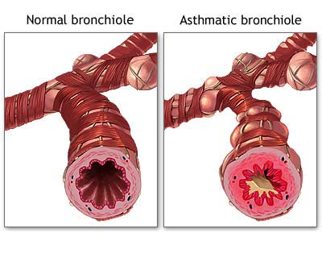
Pathophysiology
Asthma is characterized by reversible, diffuse lower-airway obstruction caused by:
Airway inflammation and edema
Bronchial smooth-muscle spasm
Excretions and mucous plugging
www.bio.davidson.edu

Slide 7
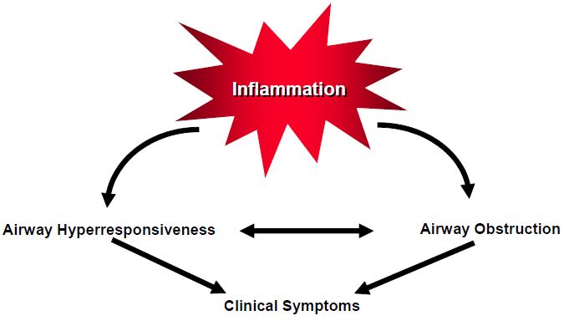
Pathophysiology
https://www.nhlbi.nih.gov/guidelines/asthma/

Slide 8
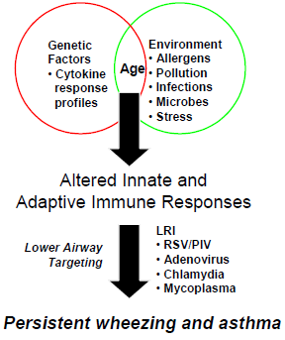
Pathophysiology
The hyperirritable and chronically inflamed airway is susceptible to acute obstruction triggered by:
Allergen exposure
Respiratory infection
Environmental irritants:
Second hand smoke
Exercise
Emotional stress
GERD
Drugs
Inflammation stimulates goblet cells and mucous glands, which leads to hypersecretion and bronchial mucous
Key: LRI: Lower respiratory illness
RSV: Respiratory Syncytial Virus
PIV: Parainfluenza virus

Slide 9
Pathophysiology
Mast cells, epithelial cells, and T lymphocytes are activated and produce pro-inflammatory cytokines.
Mediators such as histamine, leukotrienes, and platelet-activating factors are increased locally and systemically.
Epithelial, especially ciliated cells are destroyed and nerve endings are exposed.
Epithelial destruction renders the airways of asthmatic patients hyperirritable.
Notes:
Correlation between the degree of epithelial destruction and airway reactivity.

Slide 10
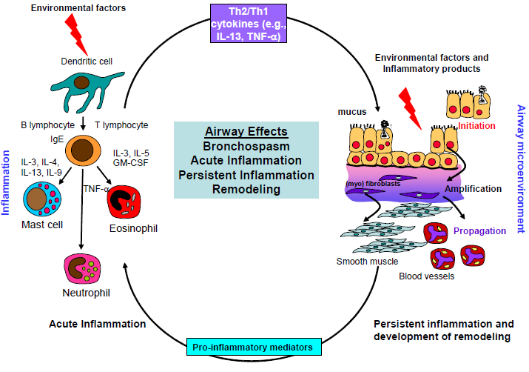
Pathophysiology
https://www.nhlbi.nih.gov/guidelines/asthma/

Slide 11
Clinical Manifestations
A child with SA has severe airway obstruction that leads to:
Increased work of breathing:
Retractions
Tachypnea
Shortness of breath
Dyspnea
Premature closure of the airway leads to increased functional residual capacity that must be overcome by more inspiratory force to offset the resistance.
Inspiration continues at higher and higher lung volumes resulting in hyperinflation and gas trapping, which leads to active expiration
Ventilation-perfusion mismatch resulting in hypoxemia
Positive alveolar pressures at end-expiration (PEEP)
Notes:
Absence of wheezing – ominous sign which indicated impending respiratory failure

Slide 12
Clinical Manifestations
Intrapleural pressures remain severely negative leading to:
Cardiac decompensation from an increased left ventricular afterload
Increased alveolar / capillary permeability
Increased risk of pulmonary edema
Hypoxia can lead to pulmonary vasoconstriction that leads to increased right ventricular output with inspiration, followed by an increased cardiac output with expiration
Pulsus paradoxus: decrease in systolic blood pressure with inspiration
Acid-base balance and oxygenation changes from hyperventilation occur
Initially respiratory alkalosis is present, but as fatigue develops, respiratory acidosis occurs.

Slide 13
Clinical Presentation
Asthma is a disease on a continuum:
An acute exacerbation in which symptoms are rapidly reversed with bronchodilators
Chronic condition that is characterized by inflammation and treated with anti-inflammatory medications
Disease of airway remodeling for which there is no defined treatment

Slide 14
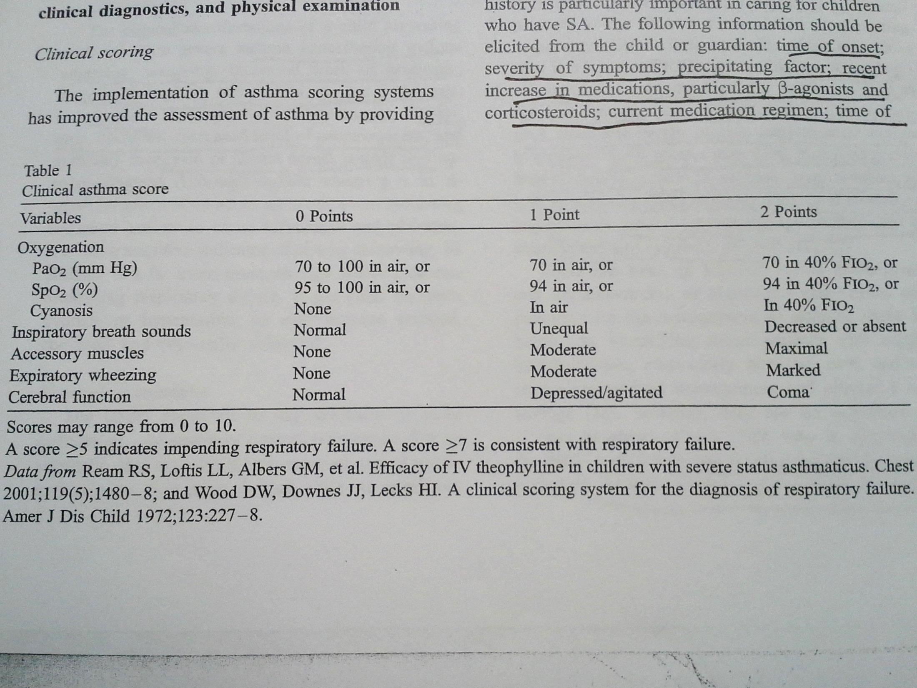
Clinical Scoring

Slide 15

Management
Asthma guidelines by the NAEPP and the NHLBI provide classification of asthma based on disease severity determined by:
Patient symptomatology
Measurement of pulmonary function
Notes:
According to the National Asthma Education and Prevention Program

Slide 16
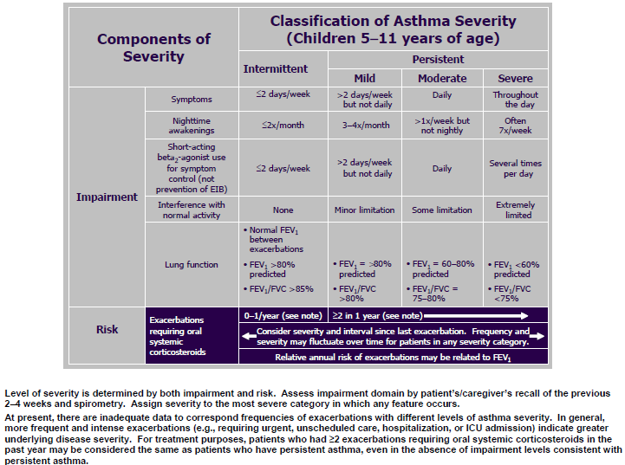
Management
https://www.nhlbi.nih.gov/guidelines/asthma/
Notes:
According to the National Asthma Education and Prevention Program

Slide 17
Management
Indications for admitting a child who has SA to a PICU include:
Mechanical ventilation history
Near-fatal asthma attack
Inability to speak full sentences
Decreased level of consciousness
Inaudible breath sounds
Supplemental O₂
PaCO₂ ≥ 40 mmHg, metabolic acidosis, lactic acidosis
Air leak syndromes
EKG abnormalities
No improvement after β-agonist therapy

Slide 18
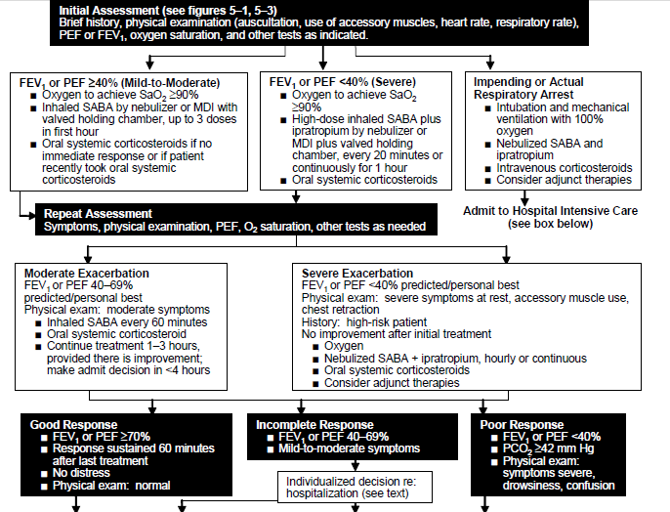
Management
https://www.nhlbi.nih.gov/guidelines/asthma/

Slide 19
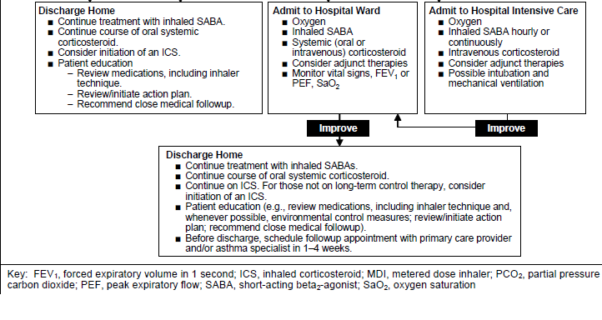
Management
https://www.nhlbi.nih.gov/guidelines/asthma/

Slide 20
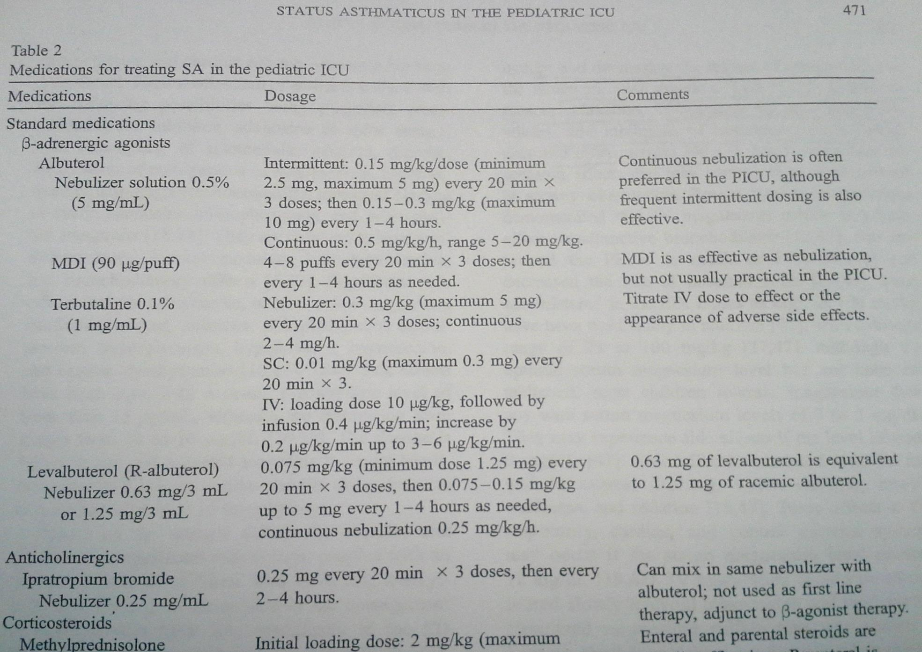
Treatment:

Slide 21
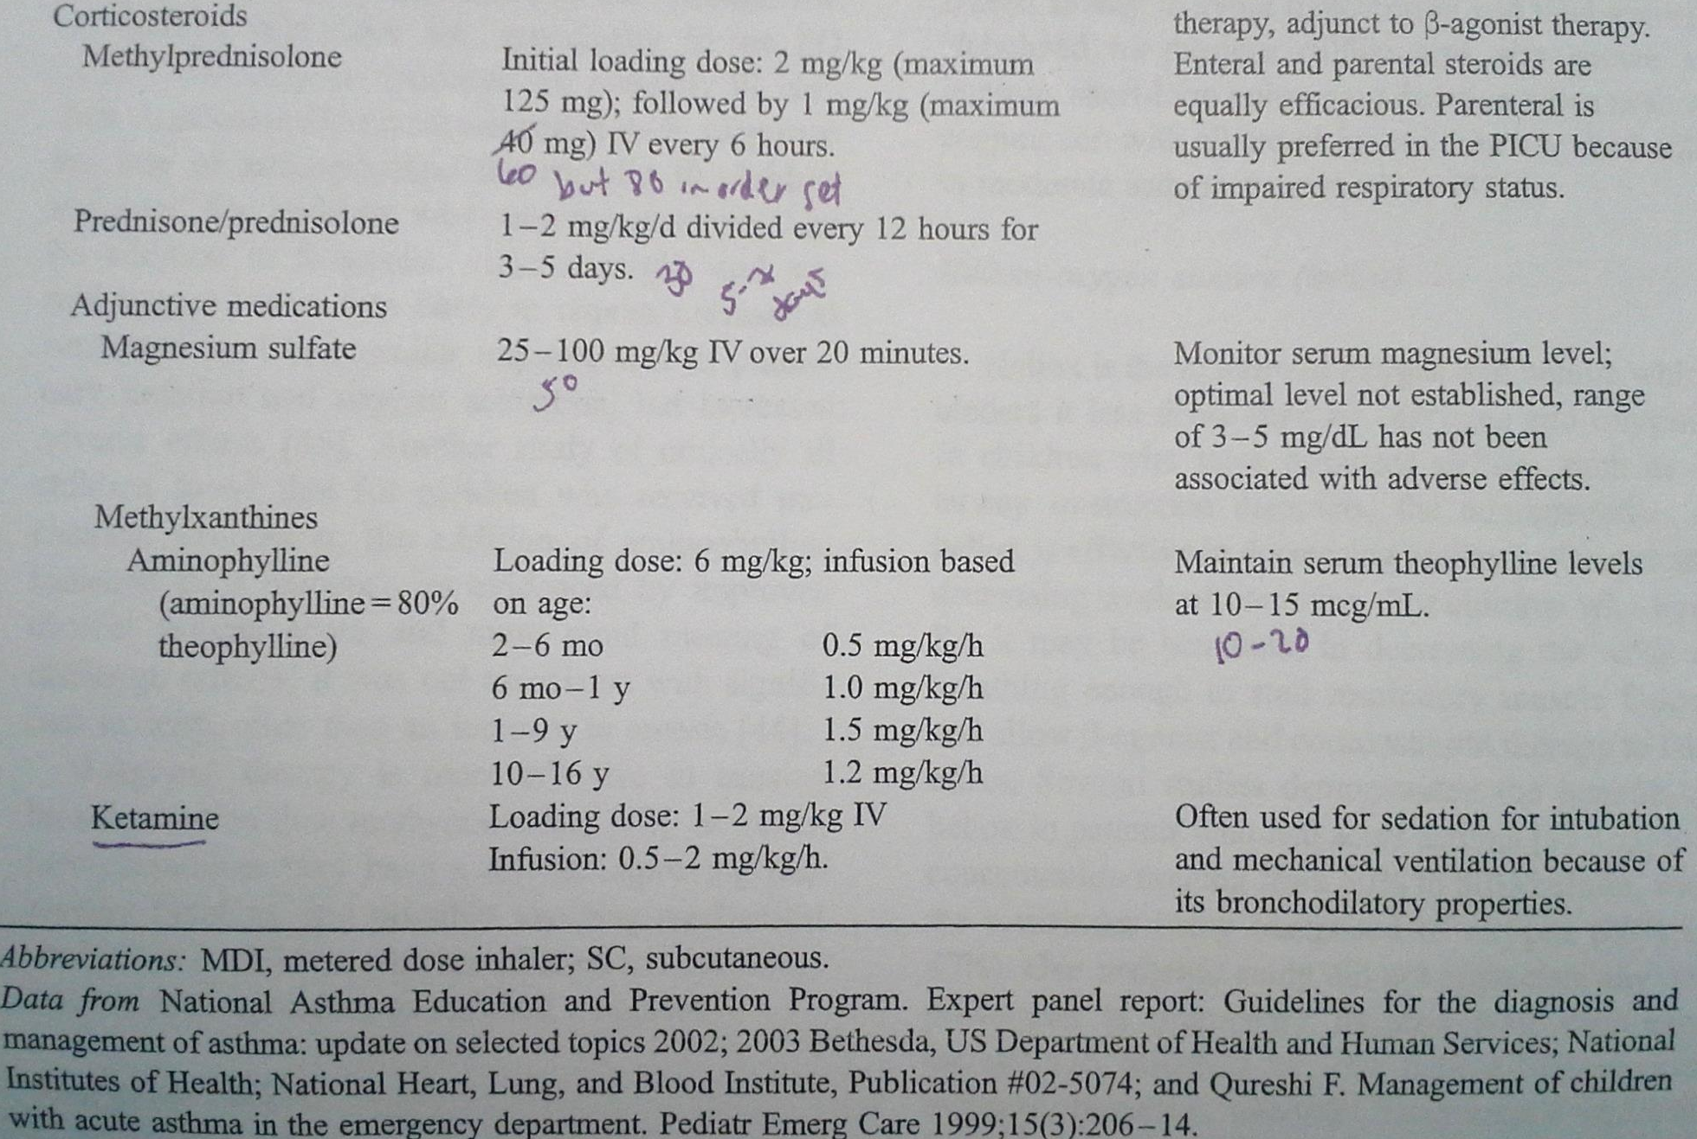
Treatment:

Slide 22
Asthma Medication list at ACH
Meter Dose Inhaler
Nebulized
Mast-Cell Stabilizer
CROMOLYN SODIUM
Short-Acting
Ventolin
Proventil
Steroid
QVAR-40
QVAR-80
Flovent HFA 220 mcg / puff
Flovent HFA 110 mcg / puff
Flovent HFA 44 mcg / puff
Short-Acting
Accuneb 2.5 / 0.5 mL
Accuneb 1.25 / 3 mL
Accuneb 0.63 / 3 mL
S2 INHALANT
Albuterol 5 mg / mL solution
Steroid / Long-Acting Combinations
ADVAIR HFA 230
ADVAIR HFA 115
ADVAIR HFA 45
SYMBICORT 160
SYMBICORT 80
Antimuscarinic / Short-Acting Combination
ATROVENT HFA
COMBIVENT RESPIMAT

Slide 23
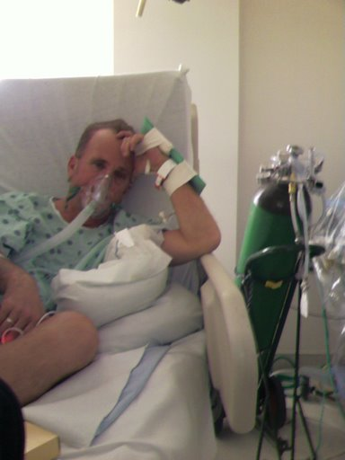
Management of S/Sx:
Heliox
Mixture of oxygen (30%) and helium (70%)
Less dense than air (80% N₂ /20% O₂)
Effective at decreasing airway resistance and decreasing work of breathing
Reduces turbulent airflow in the lungs
Notes:
Nitrogen 80%/Oxygen 20% in air

Slide 24
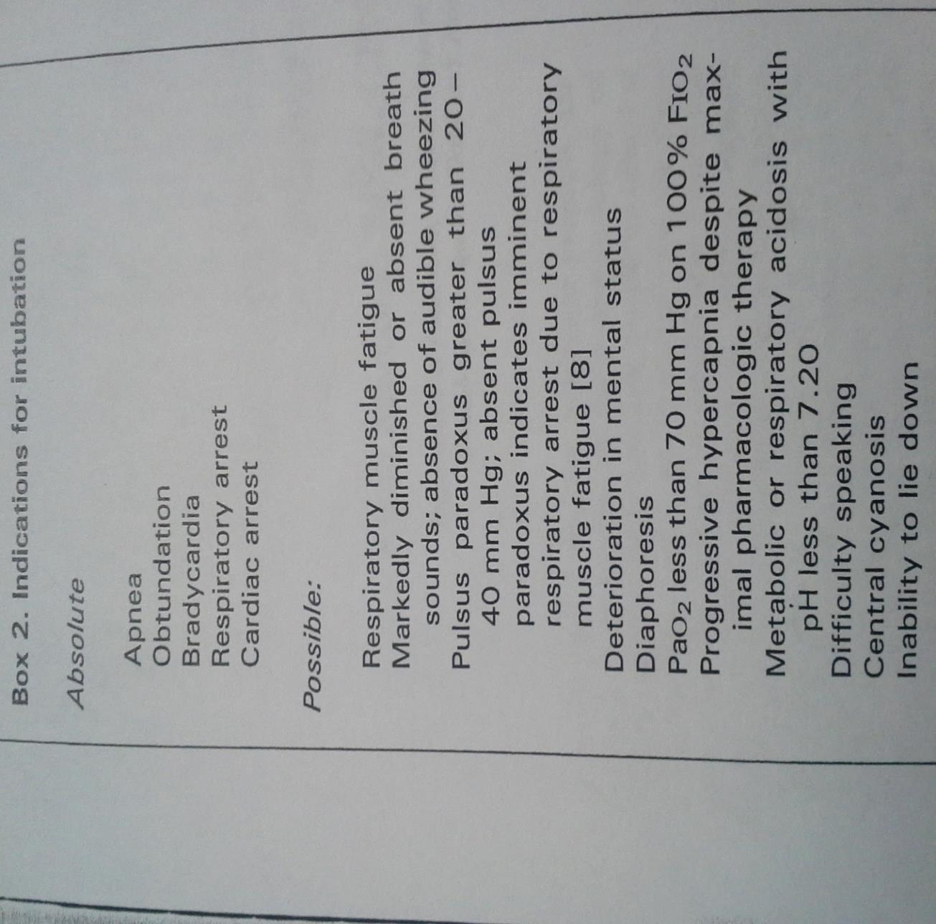
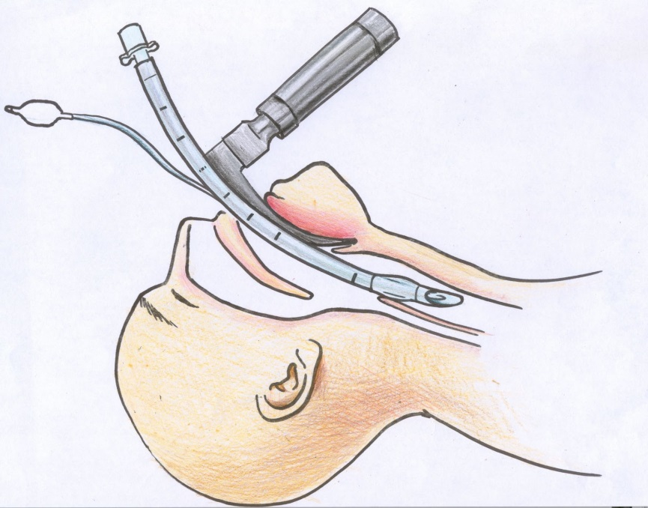
Management of S/Sx:
Expert panel report: guidelines for the diagnosis and management of asthma
Notes:
Nitrogen 80%/Oxygen 20% in air
Obtundation refers to less than full alertness (altered level of consciousness), typically as a result of a medical condition or trauma.

Slide 25
Patient Case
JT is a 9 yo female, Wt: 24 kg, transferred to ACH on 05/23/2014 in S.A.
CC: Difficulty breathing
HPI: Unrecognized intermittent to mild, persistent asthma, previously diagnosed as bronchitis.
History of wheezing over the last few years
Intermittent albuterol by nebulization
Has not taken asthma medications for a while
Fever for the past 12 Hr
Progressive difficulty breathing over the past 24 Hr
Immunizations are current
Unclear if JT has any allergic triggers
NKDA
Regular diet
Family History: Asthma on father’s side, No smokers in the home

Slide 26
Patient Case
HPI:
JT was in her usual state of health until Wednesday when she started having cold symptoms; runny nose, cough, with a mild nonproductive cough.
JT’s symptoms continued to worsen and she developed headaches and difficulty breathing.
Could barely speak before getting tired by Thursday evening.
Later that evening, JT slowly laid on the floor with respiratory distress, breathing very rapidly with an elevated HR, and the mother contacted EMS.
JT received continuous albuterol, Atrovent x2, Solu-Medrol 24 mg IV, NS 500 mL IV bolus, and magnesium sulfate IV with no improvement per outside facility.
CBC, CMP, and a rapid strep test: unremarkable
Chest X-Ray: normal

Slide 27
Management
Indications for admitting a child who has SA to a PICU include:
Mechanical ventilation history
Near-fatal asthma attack
Inability to speak full sentences
Decreased level of consciousness
Inaudible breath sounds
Supplemental O₂
PaCO₂ ≥ 40 mmHg, metabolic acidosis, lactic acidosis
Air leak syndromes
EKG abnormalities
No improvement after β-agonist therapy

Slide 28
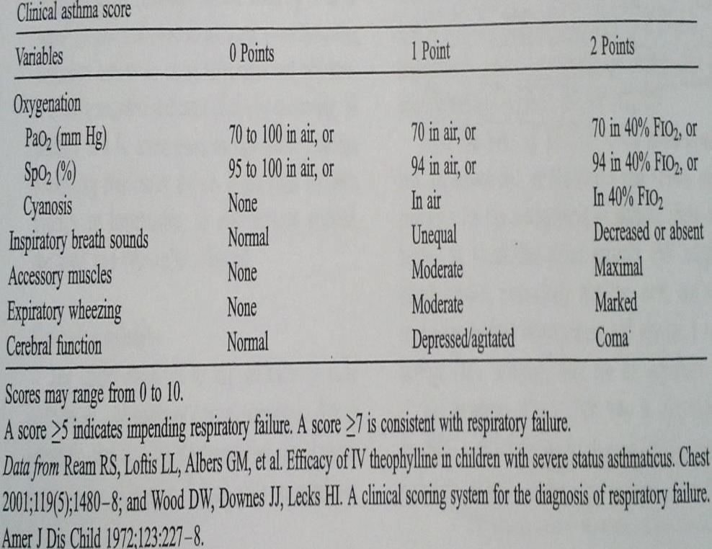
Patient Case: Day 1
Vital Signs: (day of admission)
Temperature: 36.8° C
HR: 158 bpm (on albuterol)
RR: 33
BP: 111 / 37 mm Hg
O₂ Sat: 95% in 30% FiO₂ through continuous aerosol
Pulmonary physical examination:
Moving good air with decreased movement on the bases
Inspiratory and expiratory wheezes
Subcostal retractions
Mild nasal flaring
Tachypneic
Asthma score: 4
Laboratory:
WNL
Imaging:
CXR: hyperinflation bilaterally
No pneumothorax present
No consolidation present

Slide 29
Patient Case: Day 1
Recommendations:
Continue acute management
Cardiopulmonary and neurologic monitoring in the PICU secondary to risk of cardiopulmonary decompensation
Obtain a Florida allergy panel from her indwelling IV
Inhaled fluticasone 44 mcg/puff, 2 puffs BID via AeroChamber
Albuterol MDI PRN
Albuterol nebulized PRN
Oral steroids continued on an outpatient basis
Switch to oral prednisolone 24 mg po BID once able to tolerate
Follow up through Tampa or New Port Richey clinics
Determine if prophylactic therapy needed in summer

Slide 30
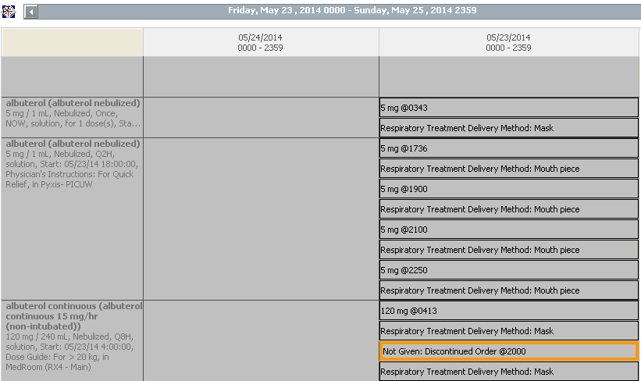
MAR Summary Day 1 & 2
Notes:
Albuterol 120mg / 8hr = 15 mg / hr

Slide 31
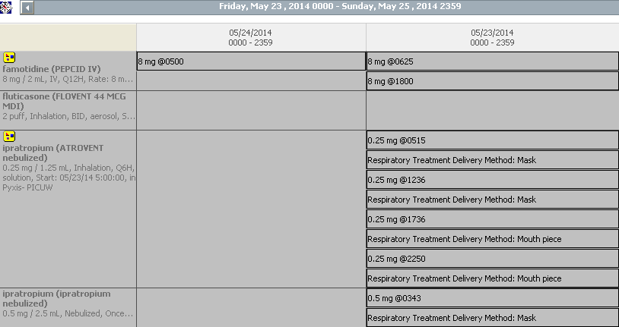
MAR Summary Day 1 & 2
Notes:
Famotidine: Stress ulcer prophylaxis: 0.25-0.5 mg/kg/dose Q 12 Hr (max 20 mg/dose)

Slide 32
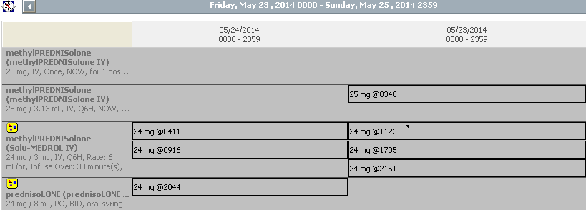
MAR Summary Day 1 & 2

Slide 33
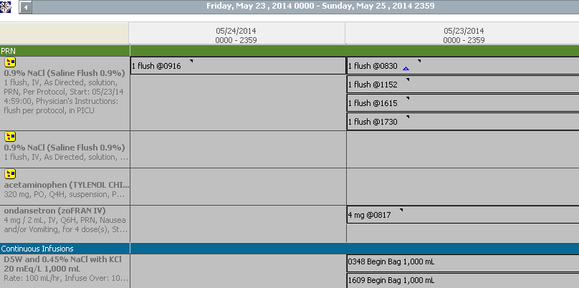
MAR Summary Day 1 & 2
Notes:
Ondansetron 0.166 mg/kg/dose (0.15 mg/kg/dose) for N&V
Rate for 24 kg child = 4*10 + 2*10 + 4 = 64 mL / hr

Slide 34
Patient Case: Day 2
Vital Signs: (day of admission)
HR: 102-169 bpm (on albuterol)
RR: 20-42
BP: 116 / 70 mm Hg
O₂ Sat: 93-98%
Medications:
Albuterol Q 3 Hr
Solu-Medrol IV Q 6 Hr
Pulmonary physical examination:
Clear to auscultation bilaterally with easy work of breathing
No wheezes heard
No retractions
Laboratory:
WNL

Slide 35
Patient Case: Day 2
Recommendations:
Cardiopulmonary and neurologic monitoring in the PICU secondary to risk of cardiopulmonary decompensation
Ongoing pulmonology evaluation and management
Albuterol interval changed to Q 4 Hr
Switch Solu-Medrol IV to Orapred
Continue regular diet
Tylenol and Zofran PRN
Transfer to floor per pulmonology

Slide 36
Patient Case: Day 3
Discharge PE & VS:
Afebrile
RR: 20
HR: 72 bpm
O₂ Sat: 97% on room air
Breath sounds clear
Asthma score 1
Plan:
Follow up in 2 – 4 weeks with New Port Richey clinic
Discharge Medications:
FLOVENT HFA 44 mcg / puff aerosol 10.6 g inhaler
Albuterol 2 – 4 puffs Q 4 Hr PRN cough, wheeze or distress
Orapred 8 mL Q Daily x 3, then stop.

Slide 37
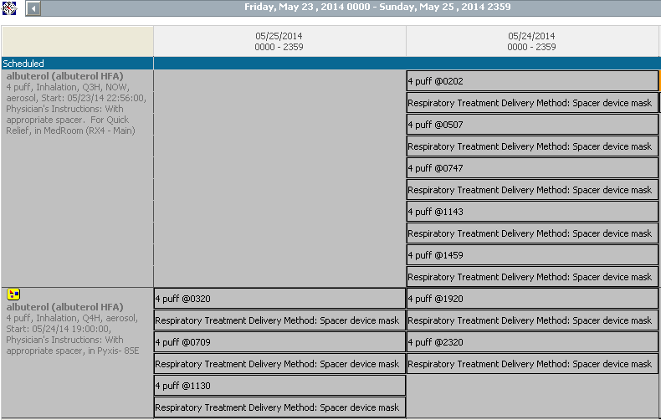
MAR Summary Days 2 & 3

Slide 38
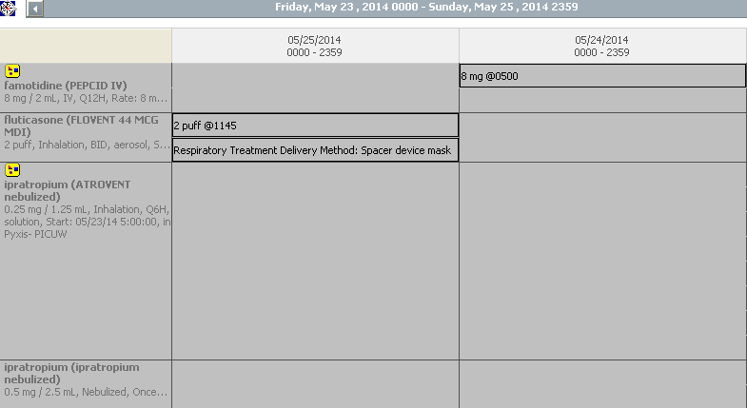
MAR Summary Days 2 & 3

Slide 39
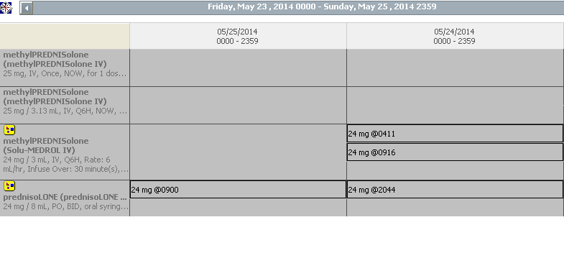
MAR Summary Days 2 & 3

Slide 40
Conclusion
Describe the pathophysiology and pathogenesis of status asthmaticus (S.A.)
Signs and symptoms associated with S.A.
Explained the management of S.A.
Reviewed the treatment options for S.A.
Answered questions pertaining to drug indication, mechanism of action, and dosing of medications used to treat S.A.
Reviewed a patient case and apply the aforementioned objectives.

Slide 41
References
Expert panel report 3 (EPR₃): Guidelines for the Diagnosis and Management of Asthma: Asthma Education and Prevention Program (NAEPP), Coordinating Committee (CC), National Heart, Lung, and Blood Institute (NHLBI) of the National Institutes of Health. Using the 1997 EPR2 guidelines and the 2004 update of the EPR2 as the framework. Publication #02-5074
W Dager and J Halilovic. Pharmacotherapy: A Pathophysiologic Approach, 8th Edition, JT. DiPiro et al, Ed. (Available Online in the Access Pharmacy Database at the UF Health Center Library)
Ream RS. Et al. “Efficacy of IV theophylline in children with severe status asthmaticus. Chest 2001; 119(5); 1480-8
Wood DW. Et al. “A clinical scoring system for the diagnosis of respiratory failure.” Amer J Dis Child 1972;
Expert panel report: guidelines for the diagnosis and management of asthma: update on selected topics 2002; 2003 Bethesda, US Department of Health and Human Services; National Institutes of Health; National Heart, Lung, and Blood Institute, Publication #02-5074
Qureshi F. Management of children with acute asthma in the emergency department. Pediatr Emerg Care 1999;15(3):206-14.

Slide 42
Questions?

